Slide 1
Animal bites: 1985-2017
By, josh thomason

Slide 2
Summary/motivation for data
Over 9000 bites recorded
What animal bites humans the most
Most common breed
What gender of said animal
Where people are getting bit.

Slide 3
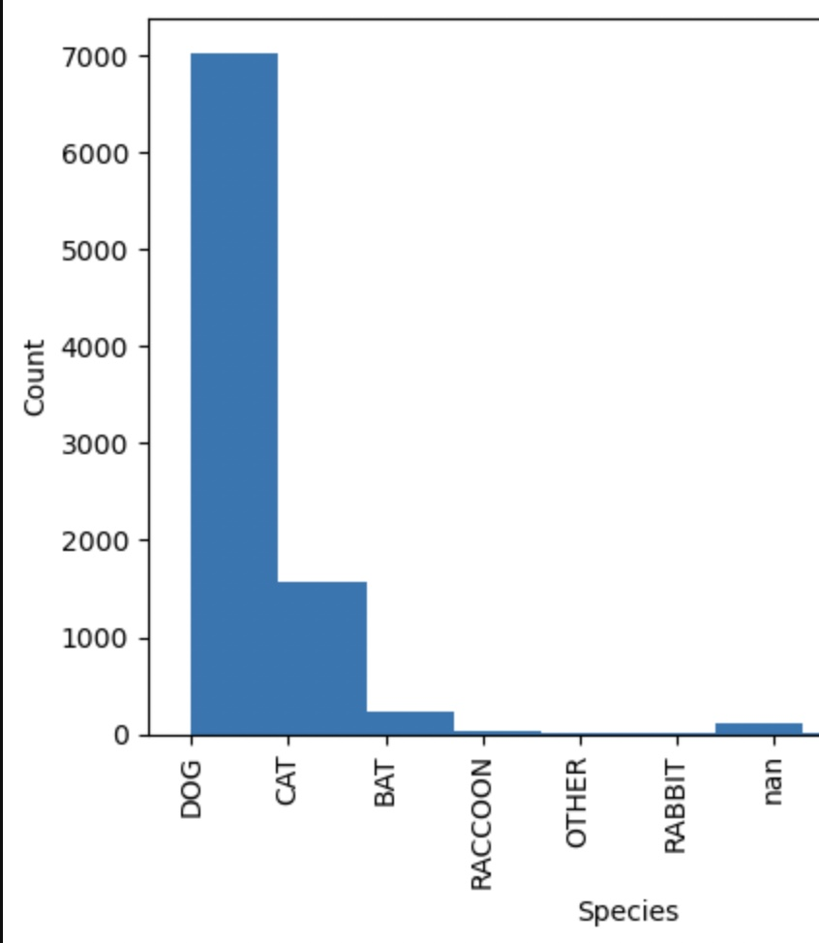
Key findings 1:
Dogs are 2x as likely to bite compared to others
41% of the time a bite is by a dog
Cats and bats are a distant second

Slide 4
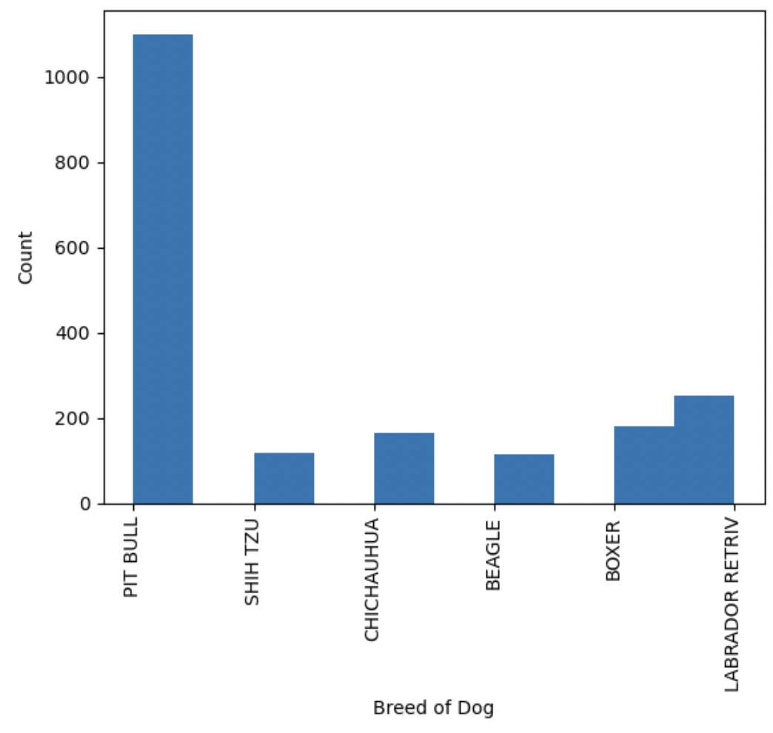
Findings 2:
Pit Bull’s are by far the most likely
Doesn’t seem to have a big dog bias
Pit bull’s are almost more likely than all cat breeds

Slide 5
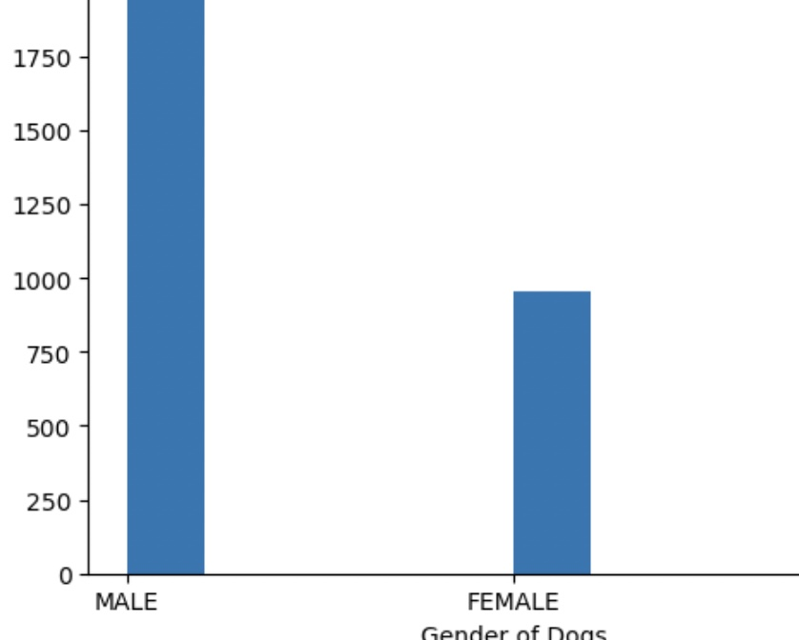
Findings 3:
There does seem to be a male majority
Based on data, male dogs are almost 2x as likely to but compared to female’s
Could be genetic differences

Slide 6
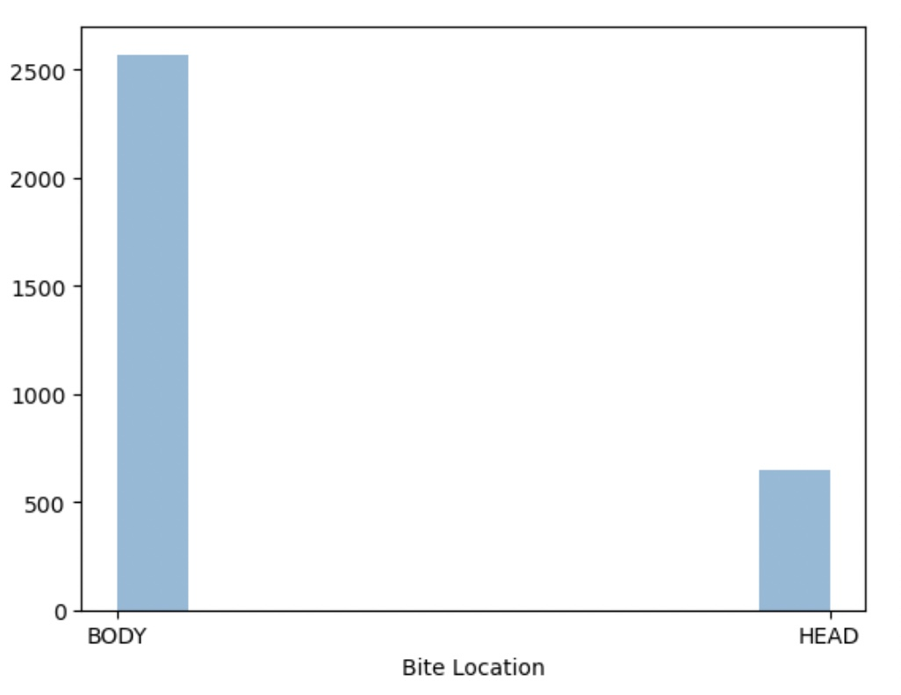
Findings 4:
Least important
Dog bites to the body are far more likely
Could be because of distance to the head for dogs

Slide 7
Summary of findings
Dogs are the most likely
Pit Bull’s seem to be the most violent out of the dog breeds
If you have a male Pit Bull, you have the highest probability of getting bit
Most violent breed (apparently)
If you suffer a bite, it will most likely be on the body & by a dog.

Slide 8
Contributing factors
Dog size
Much bigger than cats, some bites probably aren’t worth reporting.
More people own dogs
Around 2x more people own dogs
Outside of dogs and cats the others weren’t domesticated
Aren’t around them all day
Difference of distance to head compared to rest of body

